Slide 1
EMPLOYEE MORALE
Cdr. Vijay Pratap Singh
Adjunct Professor, TCET

Slide 2




CONTENTS
DEFINITION & MEANING
TYPES OF MORALE
FACTORS AFFECTING MORALE
MEASUREMENT OF MORALE
WAYS TO IMPROVE MORALE
CONCLUSION
2

Slide 3


“
It is a state of mind or of a willingness to work which intern affect the individuals or organisation objectives.”
-Theory by Jucius
3

Slide 4



MEANING:
Morale refers to a feeling of enthusiasm, real courage, confidence in the individual or group that they will be able to do the task or work given to them.
Individual morale is a single person's
attitude towards work, environment etc.
Group morale reflects the general
attitude of a group of persons.
Morale is a group phenomenon.
4

Slide 5
INTRODUCTION OF EMPLOYEE MORALE
Morale in general sense is referred to 'willingness to work'.
High morale is the result of job-satisfaction which is again the result of motivational attitude of the management.
Example: zeal, enthusiasm, loyalty dependability, etc.
Low morale exists when attitude inhibit the willingness and ability of an organisation
Example: lack of interest, laziness, apathy, jealousy, quarrelsome
5

Slide 6


CHARACTERISTICS OF EMPLOYEE MORALE
It is an attitude of mind, a state of well being, and an emotional force.
It affects output, enthusiasm, discipline, initiative and other ingredients of success.
It resides in the minds and emotions of individuals and in the reactions of their group or groups.
6

Slide 7

Individual-groups, high-low,...

Slide 8
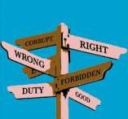



INDIVIDUAL AND GROUP MORALE
INDIVIDUAL MORALE
Single person's attitude towards work, environment etc
Increases quality of work
Individual's personal perception of the present conditions may be high
GROUP MORALE
General attitude of a group of persons
Everybody's concern and may go on changing with the passage of time
Group's perception may be low
8

Slide 9



HIGH AND LOW MORALE:
HIGH MORALE
High levels of productivity
Increases quality of work
Employee loyalty
Reduces cost.
Willingness to co-operate.
LOW MORALE
High rates of Absenteeism .
Increasing Customer complains.
Low level of enthusiasm.
Silence during employee
meetings.
Conflicts between employees.
9

Slide 10

FACTORS AFFECTING EMPLOYEE MORALE
The Organization: Major influence on the attitude of the employees towards their work
Education level of the
employees: The
educational level and the morale of the employees have an inverse relation with each other.
The Level of Satisfaction and Supervision: High satisfaction level such as high job security, stable work environment, good co-operation level etc.
The Employee's Age:
High age are more satisfied
as they are quite mature and loyal as compared to the younger workers. And more,...
10

Slide 11



MEASUREMENT OF MORALE
Observation of employees attitude and
behaviour:
The supervisors observe the actions and behaviour of the employees.
Changes in the attitude and behaviour of the employee
are the indicators of high and low morale.
2. Morale survey:
- It is used to know the feelings and attitude of the employees towards their jobs, supervisors and organization.
- Can be done in 2 ways: (a) Interview (b) Questionnaire
11

Slide 12

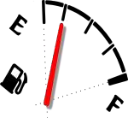

MEASUREMENT OF MORALE
Morale Indicators:
Tends to show the opinions of employees towards the organization and its management.
Examples: absenteeism, turnover, excessive waste and
scrap, etc.
Management should take necessary and appropriate steps to elevate and boost up morale of the employees.
When employee turnover is high, the morale low!
When productivity is high, the morale is also considered to be high
12

Slide 13


MEASUREMENT OF MORALE:
4. Counselling:
- To assist employees with their problems and complains and put them on a right track promptly.
- Counsellors use behavioural scientist methods to tackle important consequences of poor employee morale
13

Slide 14

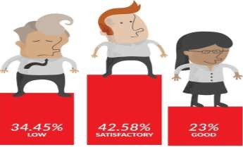
WAYS TO IMPROVE EMPLOYEE MORALE
1. Celebrate accomplishments : 2. Communicate :
Take the time to provide positive feedback and acknowledge the accomplishments and success of employees.
Be as transparent with your
employees as possible. Communicate often and take into consideration what an employee says.
3. Encourage good work-life balance :
Happy employees are most productive, it makes sense for companies to compensate the staff for pay and benefits outside work.
14

Slide 15


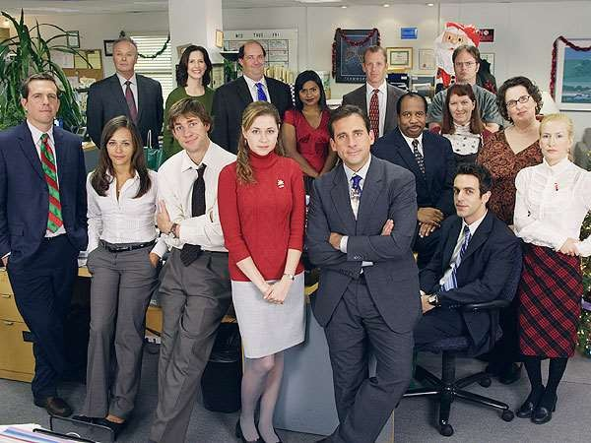
CONCLUSION
Morale is an intangible and subjective concept.
Therefore it cannot be measured directly. If we want to build a
high morale in our organization as well as our life we should maintain a good relationship with each and every one.

Slide 16
The End17

